Slide 3
Key ICAO provisions and activities related to Aviation Cybersecurity
Nicolas Rallo
Regional Director
ICAO European and North Atlantic Office

Slide 4
Introduction
Key ICAO provisions on Aviation Cybersecurity
ICAO Governance Structure for Aviation Cybersecurity
Key ICAO activities in Aviation Cybersecurity
Conclusion

Slide 5
Introduction

Slide 6
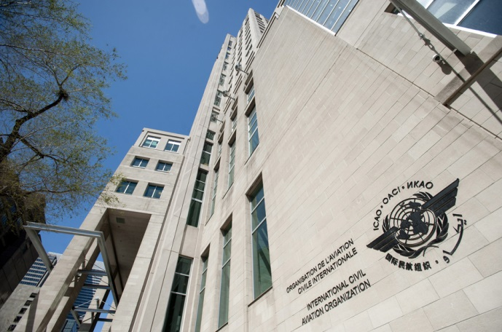
A UN specialized agency
for civil aviation
Established 1944 on basis of Chicago Convention
Headquartered in Montréal, QC, Canada
7 Regional offices + 1 RSO
193 Contracting States
19 Annexes, containing Standards and Recommended Practices (SARPs)
Policies, plans, procedures and guidance material
3 key roles : standardization; audit&monitoring ; capacity building & implementation support

Slide 7
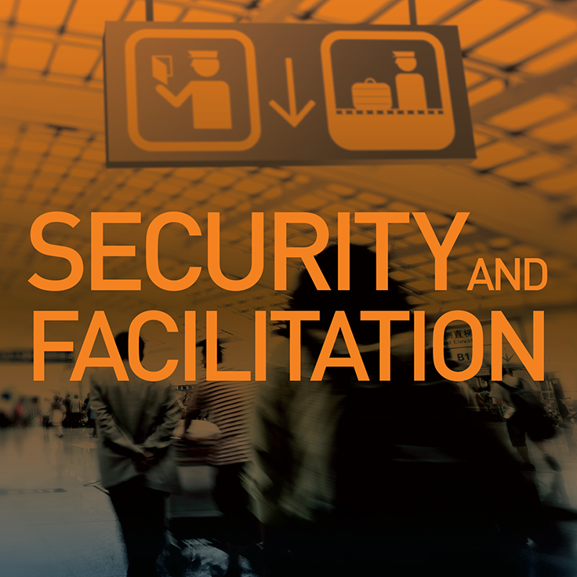
ICAO : the UN specialized agency for civil aviation
Vision
Mission
Achieve the sustainable growth of the global civil aviation system
To serve as the global forum of States for international civil aviation
ICAO Strategic Objectives

Slide 8
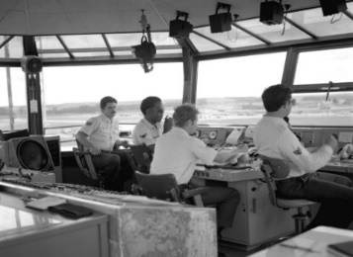
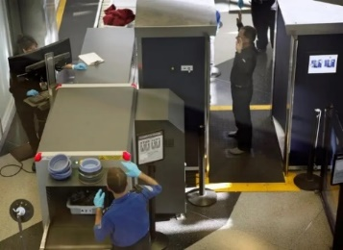
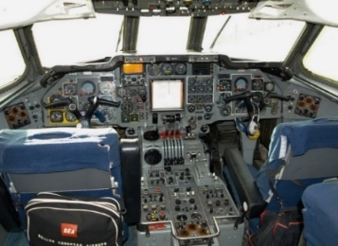
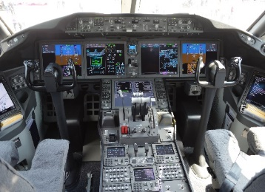
A global challenge calling for a global and coordinated response
Impact of Technology
Source: Airbus

Slide 9
Key ICAO provisions for Aviation Cybersecurity

Slide 10
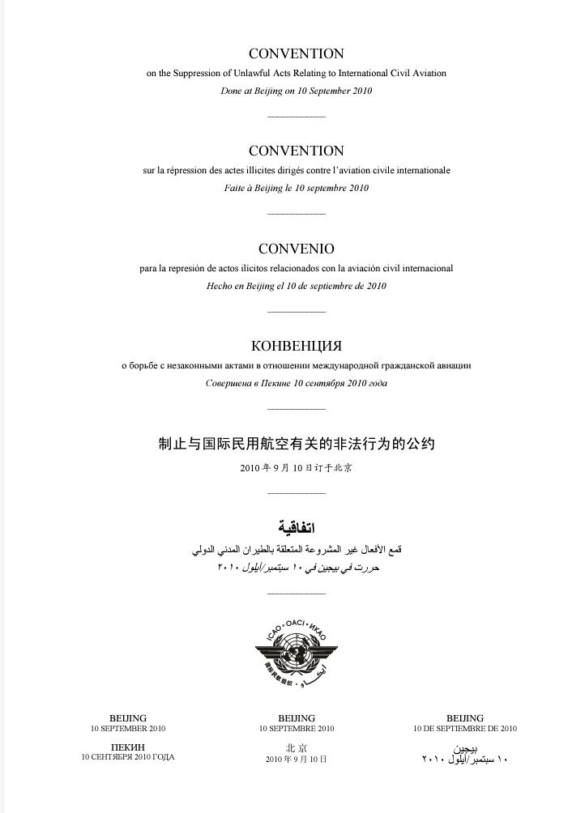
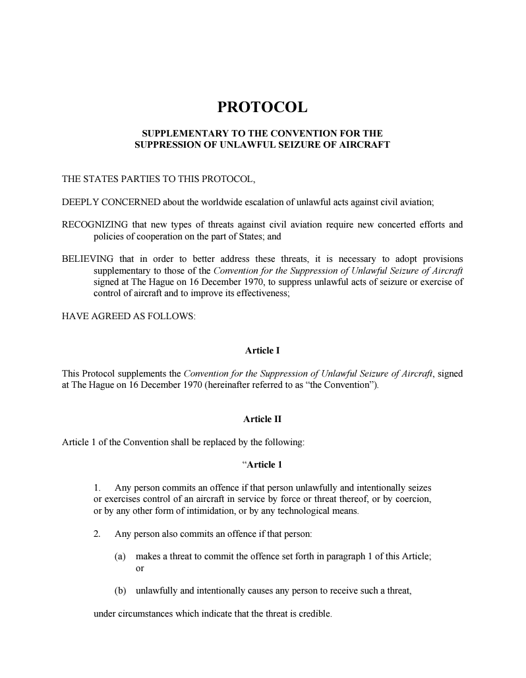
International Legal Instruments
The Beijing Convention (2010)
The Beijing Protocol (2010)
Governments’ Adoption of the Beijing Instruments is an Important
DETERRENT of Cyber-Attacks
Against Civil Aviation

Slide 11
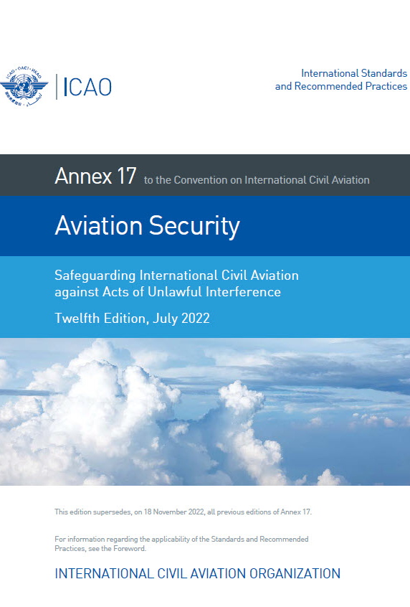
Standards & Recommended Practices
Annex 17 to the Chicago Convention – Aviation Security
Standard 4.9.1
Each Contracting State shall ensure that operators or entities as defined in the national civil aviation security programme or other relevant national documentation identify their critical information and communications technology systems and data used for civil aviation purposes and, in accordance with a risk assessment, develop and implement, as appropriate, measures to protect them from unlawful interference
Recommended Practice 4.9.2
Recommendation— Each Contracting State should ensure that the measures implemented protect, as appropriate, the confidentiality, integrity and availability of the identified critical systems and/or data. The measures should include, inter alia, security by design, supply chain security, network separation, and the protection and/or limitation of any remote access capabilities, as appropriate and in accordance with the risk assessment carried out by its relevant national authorities.

Slide 12
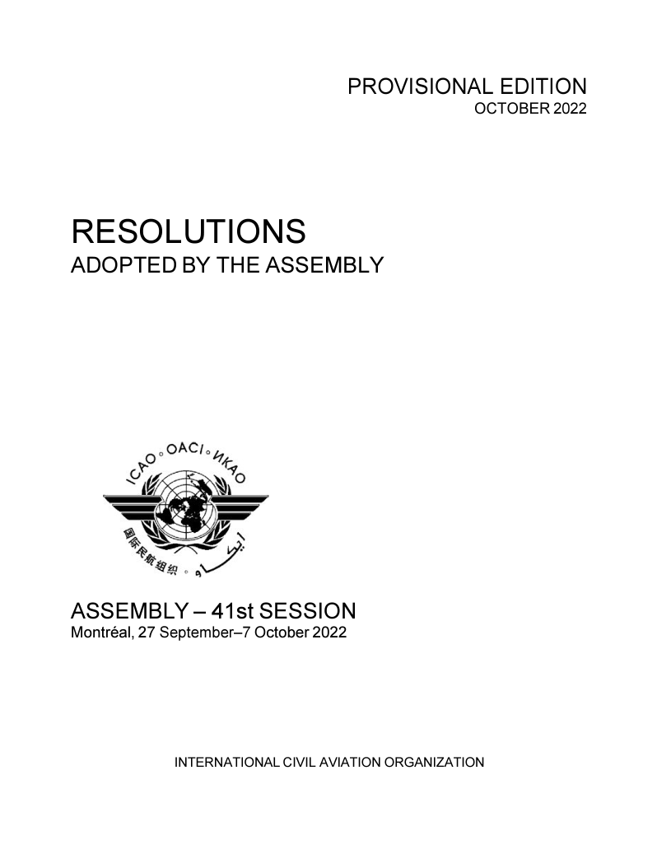
Assembly Resolutions
ICAO 41st Assembly Resolution A41–19: Addressing Cybersecurity in Civil Aviation
Highlights the need for global adoption of the Beijing Instruments
Recognizes the need for aviation cybersecurity to be harmonized
Calls upon States to (not an exhaustive list):
implement ICAO Aviation Cybersecurity Strategy, and make use of the ICAO Cybersecurity Action Plan
encourage government/industry coordination with regard to aviation cybersecurity strategies, policies, and plans, as well as sharing of information to help identify critical vulnerabilities that need to be addressed
develop and participate in government/industry partnerships and mechanisms, nationally and internationally, for the systematic sharing of information on cyber threats, incidents, trends and mitigation efforts
design and implement a robust cybersecurity culture across the civil aviation sector
https://www.icao.int/aviationcybersecurity/Documents/A41-19.pdf

Slide 13
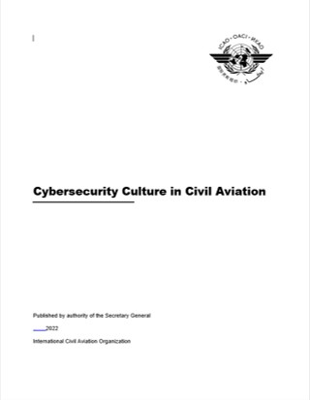
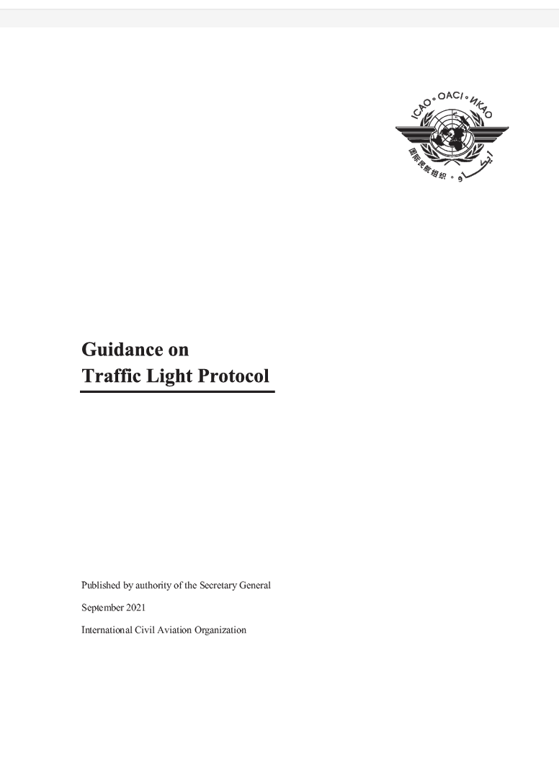
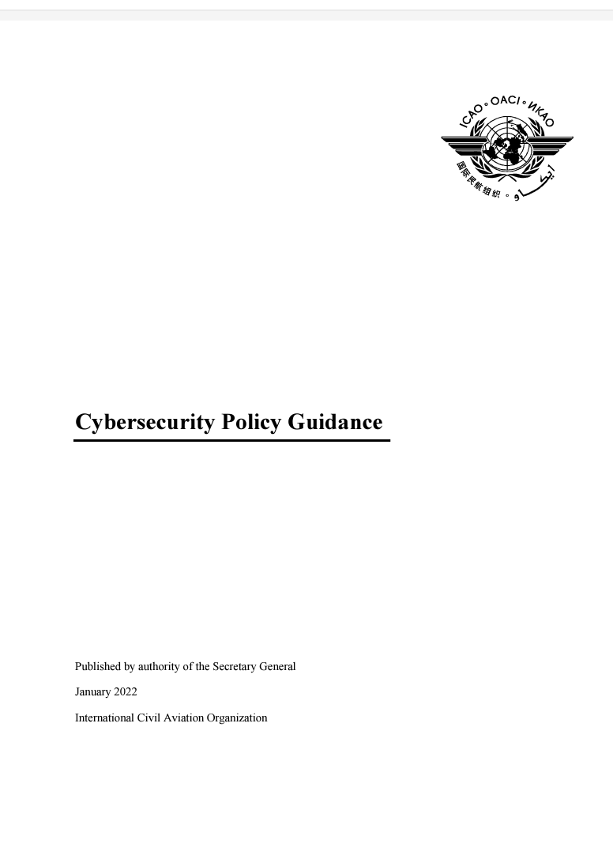
Aviation Cybersecurity Guidance Material
Doc 8973 – Aviation Security Manual
Doc 9985 – ATM Security Manual
Aviation Cybersecurity Strategy
Cybersecurity Action Plan
Using Traffic Light Protocol
Cybersecurity Culture in Civil Aviation
Cybersecurity Policy Guidance
https://www.icao.int/aviationcybersecurity/Pages/Guidance-material.aspx

Slide 14
ICAO Governance Structure for Aviation Cybersecurity

Slide 15
Governance Structure to Address Aviation Cybersecurity in ICAO
Council
ANC
ASC
ATC
Ad-hoc Cybersecurity Coordination Committee
Cybersecurity
Panel
AVSEC
Panel
Concerned ATC Panels
Concerned ANC Panels
Trust Framework Panel
TFSG
SSGC

Slide 16
ICAO Council’s Ad-Hoc Cybersecurity Coordination Committee (AHCCC)
IMP
One Member of Each of the Council’s Aviation Security Committee (ASC), Air Transport Committee (ATC).
One Member from the Air Navigation Commission (ANC).
One Member of Each ICAO Expert Group Regularly Addressing cybersecurity in its Work Programme (ATMRPP, AVSECP, CP, CYSECP, FALP, IMP, NSP, PTLP, RPASP, TFP)
CP
FALP
ATMRPP
AVSECP
TFP
RPASP
NSP
CYSECP
PTLP

Slide 17
AHCCC – Terms of Reference
The AHCCC is a Technical Coordinating Committee of the Council established to coordinate aviation cybersecurity-related work across ICAO. It serves as the main advisory body of the Council on all aviation cybersecurity matters.
Working Closely with the ASC, ATC, and ANC, the AHCCC shall:
Advise the Council on policy, strategic direction, priorities and activity planning and other aviation cybersecurity issues, as required
Examine existing and emerging aviation cybersecurity threats and hazards
Develop and maintain a comprehensive ICAO Aviation Cybersecurity Work Programme, to coordinate ICAO cybersecurity work across all aviation domains
Monitor the implementation of the Aviation Cybersecurity Strategy and the Cybersecurity Action Plan and oversee the development of updates thereto

Slide 18
ICAO Cybersecurity Panel – At a Glance
June 2023
Second Meeting
of the CYSECP
32 Members
More than 50 State Observers
18 International Organizations and Industry Observers
May 2022
First Meeting of the CYSECP
March 2022
ASC approves CYSECP membership
Adequate Geographical Distribution
October 2021
ASC approves establishment of the CYSECP and its ToR
~40/60% Gender Distribution
(at establishment)
March 2021
Council approves new governance structure to address aviation cybersecurity in ICAO

Slide 19
ICAO Cybersecurity Panel – Second Meeting – June 2023
101 Participants
41 Member States and 10 International Organizations and Industry
In-Person Meeting

Slide 20
ICAO Cybersecurity Panel – Current Structure & Activities
Cybersecurity Panel
WG on Cyber Threat & Risk
WG on Cybersecurity Guidance Material
Cyber Threat & Risk Assessment Methodology & Scenarios
Cyber Threat Categories
Aviation Cybersecurity Terms Glossary
Document on Methodology and global cyber threat
& risk landscape (Global Cyber Risk Considerations)
Principles for Integrating Aviation Cybersecurity in SSP/NACSP
Cyber incident Reporting
Cyber Information Sharing
Cyber Incident Response & Recovery & Coordination with
Organizational Emergency Response Plans
Analysis of Potential Need for Aviation Cybersecurity Provisions in the Annexes to the Chicago Convention

Slide 21
Trust Framework Panel
First meeting held from 27 to 31 March 2023
In-person meeting in Montreal
40 Participants
10 Member States
6 International Organizations
5 Specialized industry

Slide 22
TFP Working Groups and Key Tasks
Working Group on Identity Management
Reference Certificate Policy
Guidance on best practices for implementing and supporting identity management
Trust Framework Considerations
Principles and considerations
Information Security Framework
Guidance material to support the implementation of the information security framework.

Slide 23
Key ICAO activities in Aviation Cybersecurity

Slide 24
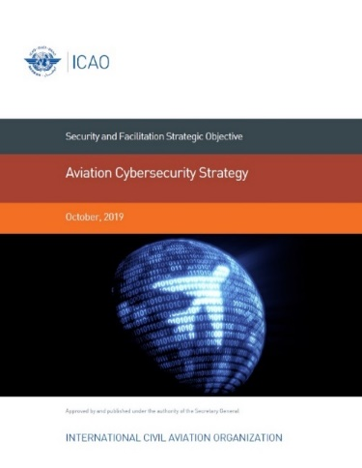
ICAO Aviation Cybersecurity Strategy
International Cooperation
Governance
Effective Legislation & Regulations
Cybersecurity Policy
Information Sharing
Incident Management & Emergency Planning
Capacity Building, Training, & Cybersecurity Culture
https://www.icao.int/aviationcybersecurity/Pages/Aviation-Cybersecurity-Strategy.aspx

Slide 25
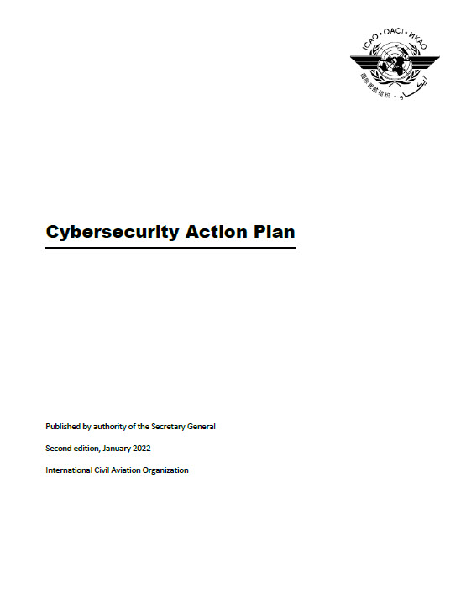
Cybersecurity Action Plan
First Edition published in November 2020
Second Edition published in January 2022
Available on ICAO Public Website
Provides the Foundation for ICAO, States and stakeholders to work together
Develops the 7 Pillars of the Aviation Cybersecurity Strategy into 32 Priority Actions, which are further broken down into 51 Tasks
https://www.icao.int/aviationcybersecurity/Pages/Cybersecurity-Action-Plan.aspx

Slide 26
ICAO Aviation Cybersecurity Training Roadmap
Developed in 2020, The Roadmap aims at:
Supporting the adoption of the ICAO Aviation Cybersecurity Strategy and the Cybersecurity Action Plan.
Supporting Member States to address cyber threats and risks.
Developing human capital, skill and competency on aviation cybersecurity.

Slide 27
ICAO Aviation Cybersecurity Capacity Building
Foundations of Aviation Cybersecurity Leadership and Technical Management (with Embry-Riddle Aeronautical University).
https://www.enrole.com/erau/jsp/course.jsp?categoryId=5586BD00&courseId=SGC-1102
Aviation Cybersecurity Oversight (with UK CAAi)
https://caainternational.com/course/icao-aviation-cybersecurity-oversight/

Slide 28
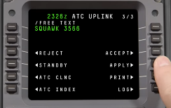
International Aviation Trust Framework
A set of principles, policy, and guidance, and a transition strategy for a globally harmonized framework that will enable a trusted exchange of information among aviation stakeholders with the level of security, resilience, and interoperability needed to support the demand for capacity and efficiency while ensuring the continued safe, secure, and sustainable operation of the civil aviation system.
MSG NOT VALIDATED
Message signature validation request
IATF
Message
Invalid

Slide 29
Conclusion

Slide 30
Key components of a robust national cybersecurity system:
Ratification of the international legal instruments
Comprehensive national regulatory framework
Holistic approach through interagency cooperation and coordination
Risk management to address new and emerging threats
Training and capacity building
Compliance monitoring

